Slide 1


INVENTORY MANAGEMENT
SYSTEM
7th Semester
PROJECT (CT705-N)
Department of Information Technology
&
Department of Computer Science
Group No: 05
Internal Guide:
Prof. Ankit Vaghela
VSITR
Prepared By:
SWEETY BHATIA -19BEIT54032
ARCHANA PANSHERIYA -19BECSE54003
BHOOMI BARAIYA -19BECSE54004
KHUSHBU SOLANKI -19BEIT54021

Slide 2
Outlines
Introduction
Problem Statement
Objective
Scope
Limitations
Prior Art Search (Literature review)
Diagrams(Flowchart, E R Diagram, Class, DFD etc)
Implementation
Conclusion & Future Works
References

Slide 3
1. Introduction
This is a web-based application that helps a certain business or shop to manage their stock or inventory online.
This project allows the business management to easily store, record, monitor their product stocks.
It was developed in Python using the Django Framework. It has a simple and pleasant functionality.­­
The "Inventory Management System" has been developed to override the problems prevailing in the practicing manual system.
This software is supported to eliminate and in some cases reduce the hardships faced by this existing system.

Slide 4
Continue…
Moreover this system is designed for the particular need of the company to carry out operations in a smooth and effective manner.
The application is reduced as much as possible to avoid errors while entering the data.
It also provides error message while entering invalid data. No formal knowledge is needed for the user to use this system.
Thus by this all it proves it is user-friendly. Inventory Management System, as described above, can lead to error free, secure, reliable and fast management system.
It can assist the user to concentrate on their other activities rather to concentrate on the record keeping.
Thus it will help organization in better utilization of resources.

Slide 5
2. Problem Statement
After analyzing many existing IMS we have now the obvious vision of the project to be developed.
Before we started to build the application team had many challenges.
We defined our problem statement as:
To make web based application of IMS for small organization.
To make the system easily managed and can be secured.
To cover all the areas of IMS like purchase details, sales details and stock management.

Slide 6
3. Objective
The main objective of the Project on Inventory Management System is to manage the details of Inventory, Vendor, Products, Cost, Orders.
It manages all the information about Inventory, Orders.
The project is totally built at administrative end and thus only the administrator is guaranteed the access.
The purpose of the project is to build an application program to reduce the manual work for managing the Inventory, Vendor, Product.
It tracks all the details about the Products, Cost, Orders.

Slide 7
4. Scope
Inventory Management System (IMS) is targeted to the small or medium organization which doesn’t have many godown or warehouses i.e. only to those organization that has single power of authority.
Some of the scope are:
Only one person is responsible in assigning the details or records
It is security driven.
Go-down can be added as per the requirement.

Slide 8
5. Limitations
Since this is our first project it has some limitation.
Due to less knowledge in particular fields and limited time we were not able to fulfill all our expectations that we expected we could do while the project got started.
We hope this limitations are considerable. Some of the project limitations are:
This application is not suitable for those organization where there is large quantity of product and different level of warehouses.
Single admin panel is only made.
It is not suitable for large organization.

Slide 9
6. Prior Art Search (Literature review)
Products are considered as the business resources for the organization. This includes managing the product with appropriate way to review any time as per the requirement.
Therefore it is important to have a computer based IMS which has the ability to generate reports, maintain the balance of the stock, details about the purchase and sales in the organization.
After analyzing the other inventory management system we decided to include some of common and key features that should be included in every inventory management system.
So we decided to include those things that help the small organization in a way or other.

Slide 10
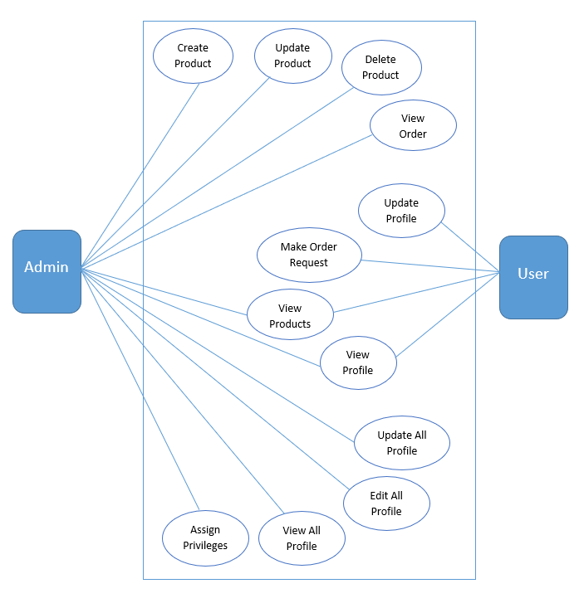
7. Use Case Diagram

Slide 11
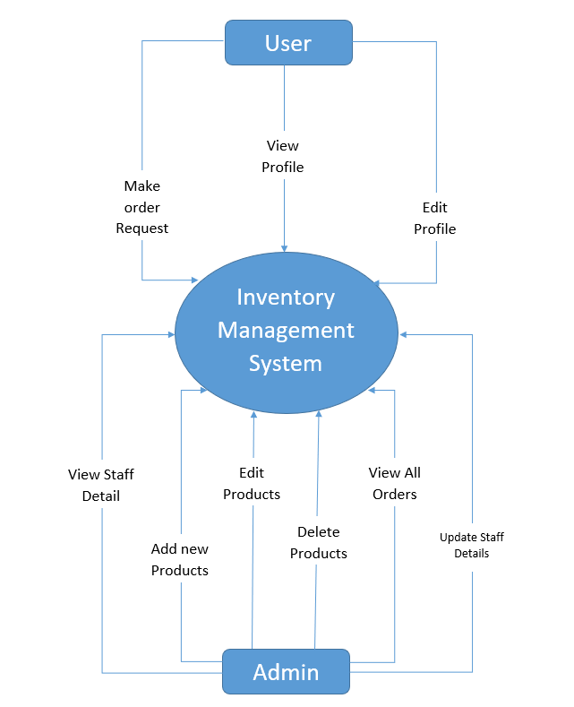
8. DFD Diagram
DFD 0 – Diagram :-

Slide 12
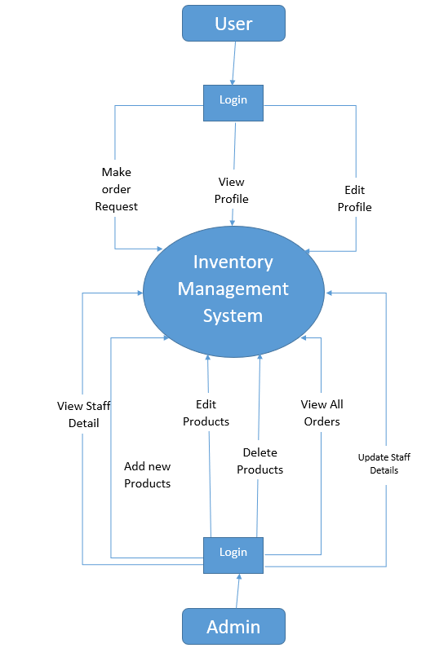
DFD 1 – Diagram :-

Slide 13
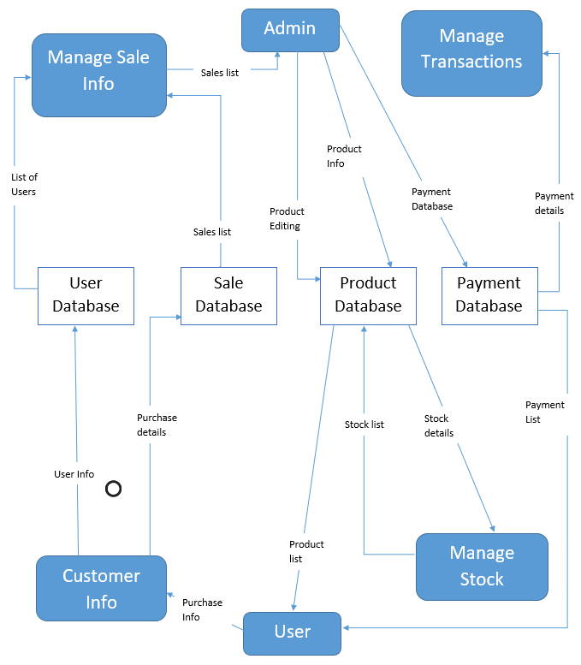
DFD 2 – Diagram :-

Slide 14
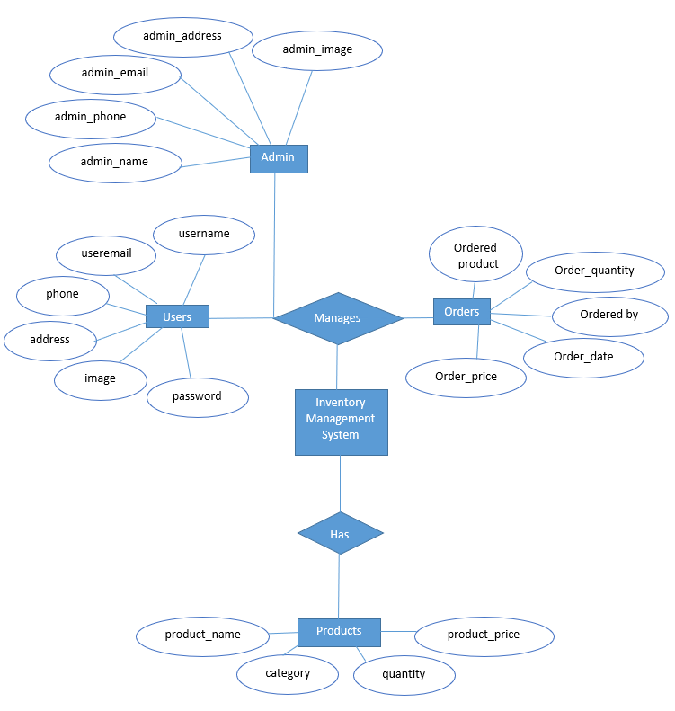
9. ER Diagram

Slide 15
IMPLEMENTATION

Slide 16
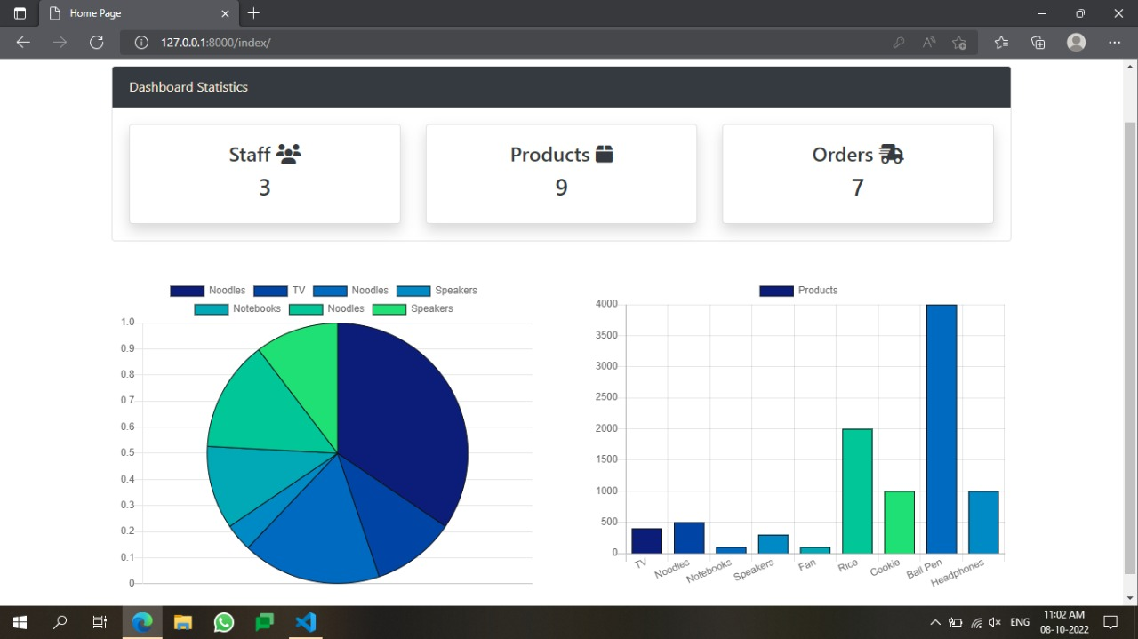
ADMIN DASHBOARD:-

Slide 17
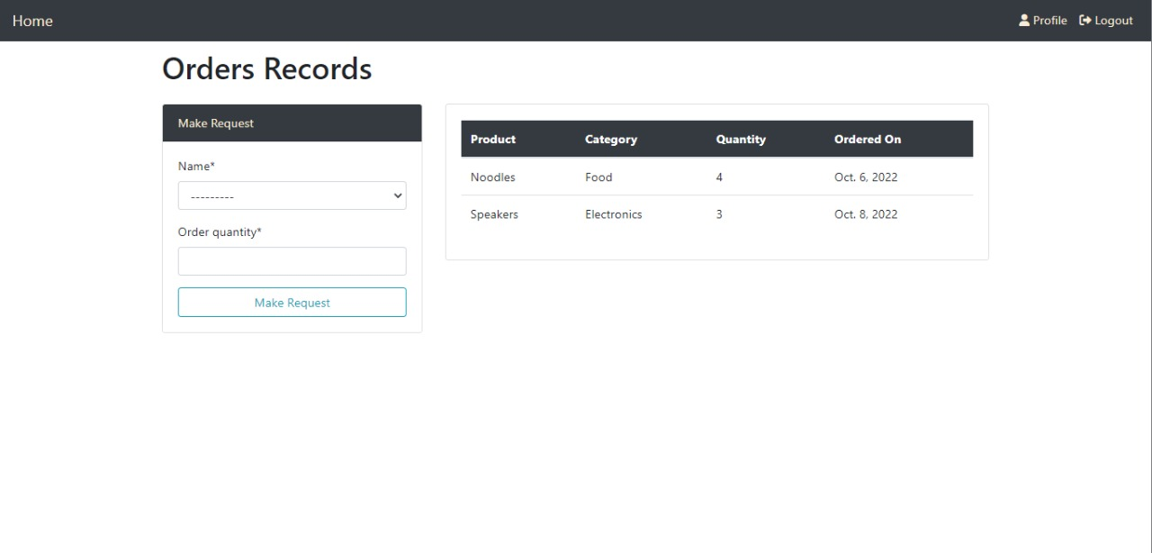
USER DASHBOARD:-

Slide 18
10. Conclusion
To conclude, Inventory Management System is a simple desktop based application basically suitable for small organization.
It has every basic items which are used for the small organization.
Our team is successful in making the application where we can update, insert and delete the item as per the requirement.
This application also provides a simple report through pie chart and bar chart of orders and products.

Slide 19
11. Future Scope
Some of the scope we can increase for the betterment and effectiveness oar listed below:
Interactive user interface design.
Manage Stock Go-down wise.
Use of Oracle as its database.
Online payment system can be added.
Making the system flexible in any type.
Sales and purchase return system will be added in order to make return of products.

Slide 20
12. References
https://www.google.co.in/
https://www.youtube.com/
https://github.com/
https://stackoverflow.com/
https://www.w3schools.com/default.asp

